Slide 1
HELICOPTER VIBRATIONS DIAGNOSTIC FOR MAINTENANCE
Presented by;
1. Pantaleo Kiruwa 20BTRAS057
2. Ibrahim Kassim 20BTRAN047
3. Theopor Henjewele 2OBTRAS067
4. Samuel Edson 20BTRAN041

Slide 2
Description and Objectives.
Several objectives and requirements are maintained for the Helicopter Vibration Diagnostic for Maintenance. Among the objectives are:
Gathering of modal data: this leads to the extraction of free-response quantities such as resonant shapes/frequencies, damping levels, and frequency/time domain response function.
The accurate gathering of data is to be accomplished using existing computational software: MSC Patran and Nastran.

Slide 3
Cont…
Placement and orientation of Vibration prone points: The project emphasizes that vibrations in helicopters are mostly caused by the rotor system, tail rotor, engine, and gearbox.
To obtain a statement of minimum loading excitation levels and their corresponding frequency ranges used.
Selection of specific correlation points and the coincidence of accelerometer measurement locations with NASTRAN model grid points.

Slide 4
MODEL CREATION AND ANALYSIS
The suggested methodology involved performing finite element analysis of a planned helicopter model with an emphasis on dynamic behaviour and precise structural component representation.
Given their complex mechanical architecture and wide range of operating situations, helicopters are highly dependent on reliable maintenance procedures, as demonstrated by a number of studies.

Slide 5
Cont..
The project took account vibrations analysis in helicopters are caused by the rotor system, tail rotor, engine, and gearbox.
These vibrations have been found to be the cause of fatigue damage to structural elements, which makes people uncomfortable, makes it difficult to read instruments, and reduces weapon systems' efficacy. Innovative HVD systems that detect and analyse these vibrations become effective instruments for condition monitoring in the helicopter sector.
Studies emphasise the growing acceptance of vibration monitoring and analysis as standard procedures, highlighting the technique's value as a predictive maintenance tool.

Slide 6
Methodology
The analysis involved distributing structural and nonstructural weight to the appropriate areas of the finite element model.
In the case of rotorcraft, most weight is of a nonstructural nature.
The mass model was generated by listing the weight and inertia properties of several components.
The analysis also involved presenting with the problem of developing an analytical damping model for the global finite element model based upon the realistic dynamic behavior of the rotorcraft fuselage.

Slide 7
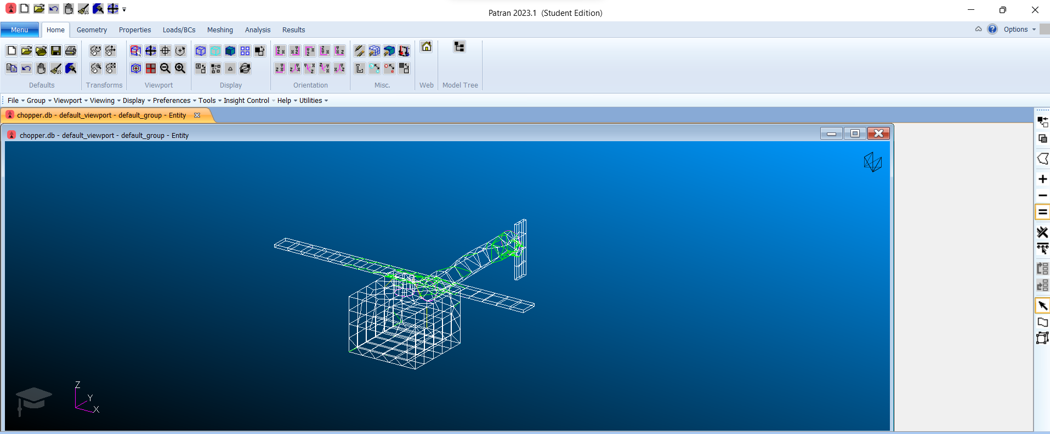
Model Analysis in Patran.

Slide 8
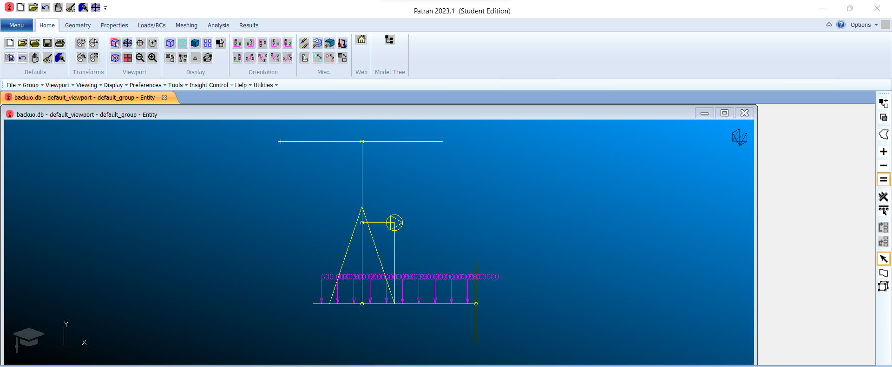
Simplified Model

Slide 9
Modeling Check.
To attain a certain level of confidence in the finite element discretization, several modeling checks are being performed to ensure that the model characterizes the true dynamic behavior of the physical structure.
Modeling checks also have the purpose of ensuring the proper representation internal and external constraint conditions in both static and dynamic analyses.

Slide 10
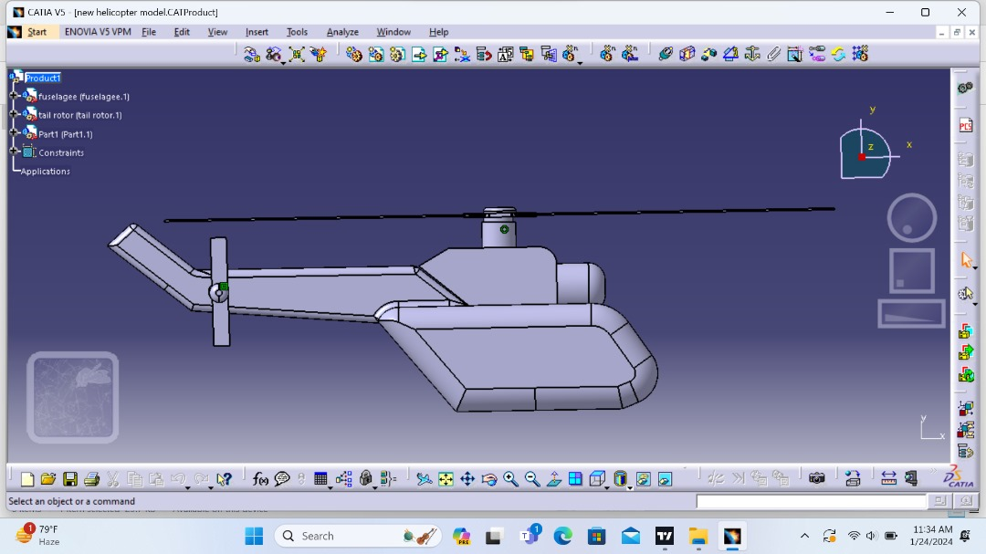
Side view

Slide 11
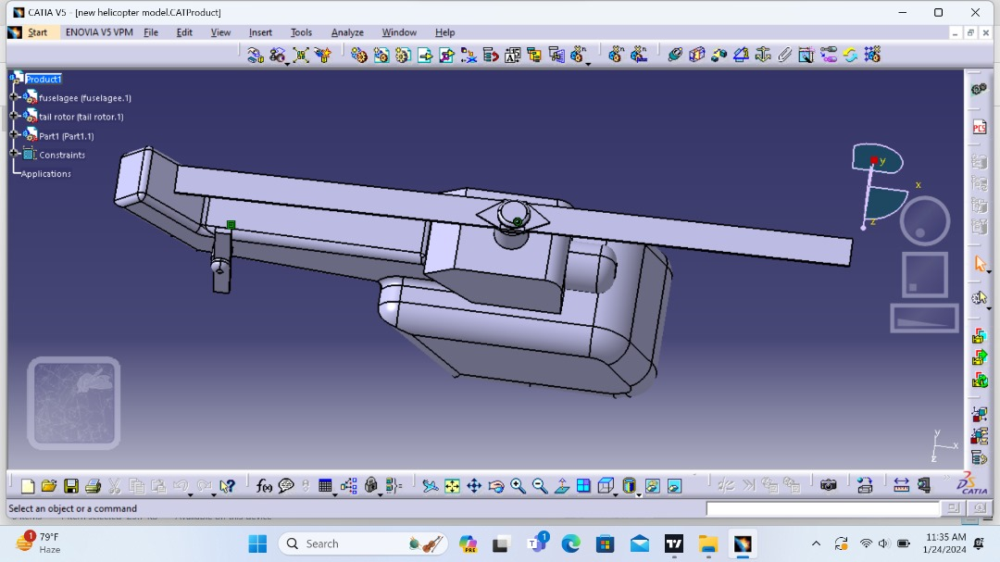
Top view

Slide 12
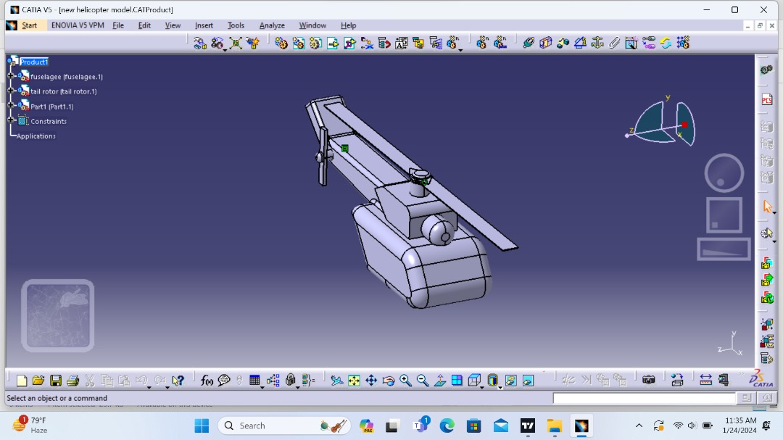
Front view

Slide 13
Mathematical Modeling of Vibrations:
Simultaneously, theoretical ideas are utilised to construct mathematical models for vibration analysis. The mathematical description of the vibrational modes of the helicopter is also achieved through the application of transfer matrix techniques and modal analysis. These models use analytical techniques to try and capture the dynamics that are intrinsic to the helicopter system.
Comparison of Results and sensitivity Analysis:
A thorough comparison between the outcomes of the MSC Nastran simulations and the mathematical models is the next important stage. To determine the effect of changing parameters on vibration response, sensitivity analyses are carried out within MSC Nastran along with a thorough evaluation of discrepancies and correlations. The comparison's findings shed light on the precision and constraints of mathematical and numerical modelling methods.

Slide 14
Validation with Experimental Data:
Validation of the models are performed by comparing the simulation results with available experimental data, ensuring that the numerical and mathematical models accurately represent the helicopter's dynamic behavior

Slide 15
Cont..
Import of Helicopter Model into MSC Nastran:
The helicopter model is imported into MSC Nastran to facilitate a finite element analysis.
Attention is given to accurately represent real-world conditions by determining material parameters, establishing boundary conditions, and defining loading scenarios.
Vibration Analysis with MSC Nastran:
MSC Nastran is employed to conduct a vibration analysis of the helicopter.
Special focus is placed on capturing dynamic behavior and vibrations originating from critical components such as the engine, gearbox, rotor system, and tail rotor.
The simulation aims to generate comprehensive vibration response data, providing insights into the various vibrational modes exhibited by the helicopter.

Slide 16
Optimization and Refinement:
An iterative optimization process is then followed, refining both models based on the comparison results and improving the overall accuracy of vibration predictions.
Documentation and Reporting:
The final step in the process is thorough reporting and documentation. A comprehensive report that covers the entire process—model development, analysis settings, comparison outcomes, and optimization recommendations—must be generated. The study will open the door for future developments in modelling techniques by offering insightful information on the benefits and drawbacks of numerical simulations for helicopter vibration analysis with MSC Nastran and mathematical models.

Slide 17
Conclusion
The potential of Helicopter Vibration Diagnostic (HVD) technology to transform helicopter maintenance procedures was thoroughly investigated in this paper, which concludes.
The methodology comprised creating and implementing the HVD system with MSC Nastran for finite element analysis, as was explained in detail throughout the discussions.

